Slide 1
CNS PROJECT
TEAM MEMBERS
SAI SHANKAR 2010030054
PS YESHWANTH 2010030122
SRIKAR KANCHE 2010030474
SAI MANASWI 2010030325
Mentor: P Lalitha Surya Kumari

Slide 2
IPv6 Addressing Scheme

Slide 3
Abstract
IP Addresses
An IP address is an address used in order to uniquely identify a device on an IP network.
The address is made up of 32 binary bits, which can be divisible into a network portion and host portion with the help of a subnet mask.
The 32 binary bits are broken into four octets (1 octet = 8 bits). Each octet is converted to decimal and separated by a period (dot). For this reason, an IP address is said to be expressed in dotted decimal format (for example, 172.16.81.100). The value in each octet ranges from 0 to 255 decimal, or 00000000 - 11111111 binary.

Slide 4
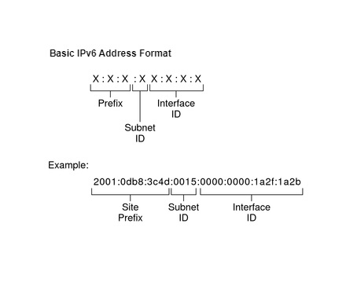
Introduction
An IPv6 address is 128 bits in length and consists of eight, 16-bit fields, with each field bounded by a colon.
Each field must contain a hexadecimal number, in contrast to the dotted-decimal notation of IPv4 addresses. In the next figure, the x's represent hexadecimal numbers.

Slide 5
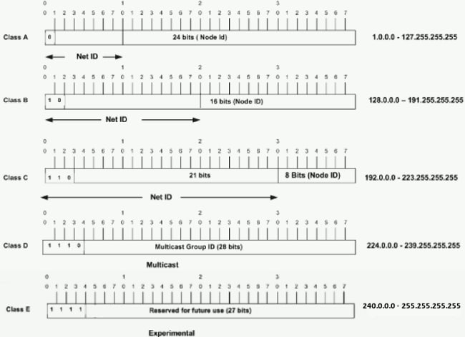
The significance in the three high order bits and the range of addresses that fall into each class

Slide 6
Literature review
Network administrators must know how to implement IPv6 in their networks.
we have been asked to set up a network for use by the sales staff for a customer demonstration.
The network will use a series of consecutive IPv6 subnets for four LANs.
Our job is to assign the subnets to the LANs and configure the routers and PCs with IPv6 addressing.
Make certain to configure all the necessary components for IPv6 routing on the routers.

Slide 7
Methods
Step 1: Determine IPv6 subnets and addressing scheme
Step 2: Configure IPv6 addressing on routers and PCs
Step 3: Verify IPv6 connectivity

Slide 8
Tools
Cisco Packet Tracer

Slide 9
Conclusion
IPv6 addresses can bring a variety of benefits, including: More efficient routing with smaller routing tables and aggregation of prefixes.
Simplified packet processing due to more streamlined packet headers. Support of multicast packet flows.

Slide 10
Text encryption using various algorithms

Slide 11

TABLE OF CONTENTS
ABSTRACT
INTRODUCTION
Literature review
PROBLEM STATEMENT
PROBLEM SOLUTION
ALGORITHM
ADVANTAGES & DISADVANTAGES
CONCLUSION

Slide 12
ABSTRACT
Users communicate over all social media, but messages are not secured when it passes through network. Intruder can access user’s message easily. We want to secure users communication over all social media.
So here we proposed a system where user will enter the plain text and select the algorithm type from AES,DES,MD5, cryptography ..... and provide the key, a chipper text will be formed that can be sent via any communication application and end user can decrypt the text by selecting the same algorithm type and must enter the same sender secret key.
User can use our application and can enter the plain text and must select the algorithm type and must enter the secret key to encrypt the message and receiver can decrypt the message by specifying the same algorithm used for encryption and must use the same secret key used by sender. Intruder will find difficult to decrypt the message. By using this method you can double ensure that your secret message is sent securely without outside interference of hackers or crackers.

Slide 13
INTRODUCTION
Encryption
* The process of converting plaintext into ciphertext
Decryption
* The process of converting ciphertext into plaintext

Slide 14

PURPOSE OF PROJECT
Provides security
File encryption
Communication encryption
Network traffic encryption
Password manager
Single sign-on

Slide 15
Literature review
In previous works they used nearly nine papers. Each and every paper contains different algorithms and different techniques to achieve text encryption.
All the methods are very efficient. But the techniques are differs depend upon the text encryption performance, access time and key management.
Future work is to review various methods more than this paper and find the best encryption method.

Slide 16
PROBLEM STATEMENT
Text encryption using various algorithms system project is an application that allows the users to send messages in an encrypted format easily. Messages are one of the common modes of communication between people.
The messages that we sent from the source to the destination is not securable. There is no guarantee that the destination receives the complete message as expected.
What if there is an application that can solve this problem?

Slide 17
PROBLEM SOLUTION
Yes, it is possible. This application allows the users to send the messages in an encrypted format and then decrypt through the use of a key that sent from the source. Various algorithms used to encrypt and decrypt messages with great ease.
This is one of the best Text encryption using various algorithm system projects application.

Slide 18
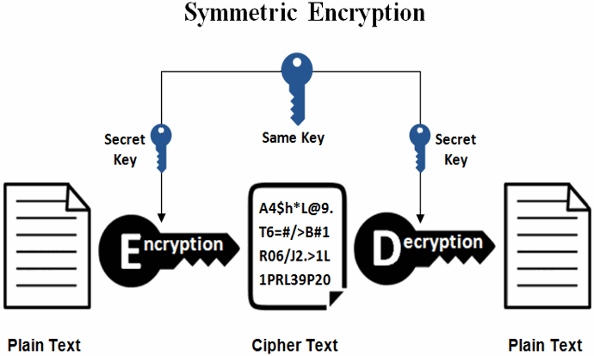
ALGORITHM

Slide 19
AES ALGORITHM
AES stands for Advanced Encryption Standard and is trusted algorithm as the standard by the U.S. government and also many organizations. It is highly efficient in 128-bit form, and it can also use 192 and 256 bits for string encryption purposes.
It is considered impervious to all the attacks, except the brute-force, which attempts to decipher messages using possible combinations such as 128,192,256-bit cipher.

Slide 20
Advantages & Disadvantages:
Advantages
Fast and easy way of to send secure stuff.
Easy process to encrypt text.
Highly secure as type of algorithm and secret key is required while encryption and decryption.
Disadvantages:
Password have to be shared which can be hacked and used.
Only small length of text can be sent like hardly 2-3 lines.
Requires active internet connection.

Slide 21
Conclusion
We use different types of algorithms to establish security services in different service mechanisms.
We use either private key cryptography or public key cryptography according to requirement.
If we want to send message quickly we use private key algorithm and if we want to send messages secretly we use public key algorithm.

Slide 22

THANK YOU

